Slide 2



Patch image
$$U_{3}(θ)$$
Amplitude
Encoding
$$U_{2}(θ)$$
Flatten
Measure
$$U_{1}(θ)$$
Input: image
Quanvolutional filter
Output: feature maps

Slide 3
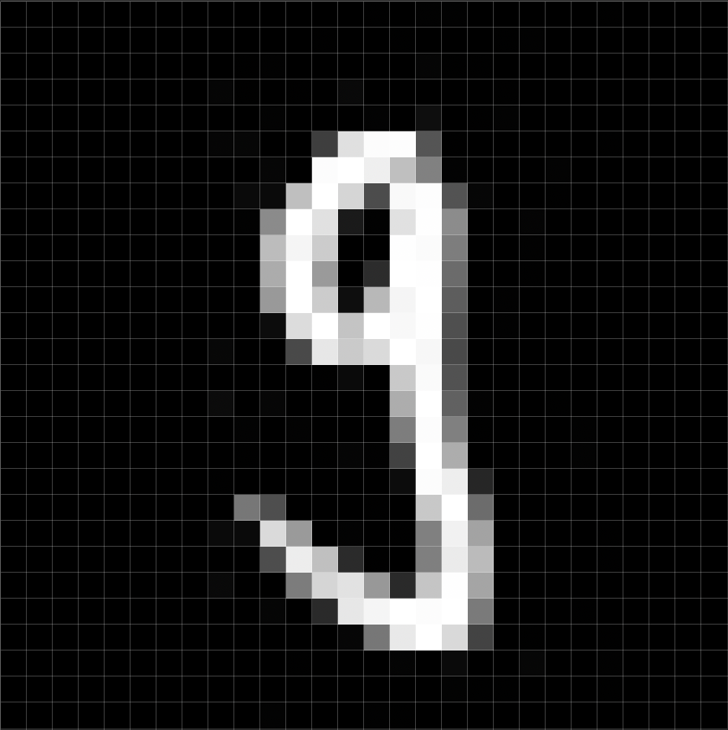






Patch image
$$U_{3}(θ)$$
Amplitude
Encoding
$$U_{2}(θ)$$
Flatten
Measure
$$U_{1}(θ)$$
Encoder $ℰ$
Circuit $𝒰$
Decoder $𝒟$
Input: image
Quanvolutional filter
Output: feature maps

Slide 4


a)
b)
c)
Image
Image
Image
Conv₁
Quantum filter
MaxPool₁
$1^{st}$ block
Conv₂
MaxPool₂
FC₁
FC₂
$2^{nd}$ block
Output

Slide 5




















$$|q_{0}⟩$$
$$|q_{0}⟩$$
$${ R}_{X}$$
$$|q_{0}⟩$$
$${ R}_{X}$$
$$|q_{1}⟩$$
$${ R}_{Y}$$
$$|q_{1}⟩$$
$${ R}_{X}$$
$$|q_{1}⟩$$
$${ R}_{X}$$
$$|q_{2}⟩$$
$${ R}_{Y}$$
$$|q_{2}⟩$$
$${ R}_{X}$$
$$|q_{2}⟩$$
$${ R}_{X}$$
$$|q_{3}⟩$$
$${ R}_{Y}$$
$$|q_{3}⟩$$
$$|q_{3}⟩$$
$${ R}_{X}$$
a)
b)
c)
$$|q_{0}⟩$$
$${ R}_{X}$$
$${ R}_{X}$$
$${ R}_{X}$$
$$|q_{1}⟩$$
$${ R}_{X}$$
$${ R}_{X}$$
$${ R}_{X}$$
d)
$$|q_{2}⟩$$
$${ R}_{X}$$
$${ R}_{X}$$
$${ R}_{X}$$
$$|q_{3}⟩$$
$${ R}_{X}$$
$${ R}_{X}$$
$${ R}_{X}$$

